Slide 1
CORE TECH & DIGITAL
SKILLS THAT TRANSFER
Foundational skills that apply across tech roles, digital tools and emerging tools
Notes:
Welcome. Today we are going to talk about skills — what they are, what you already have, and how to use them to get into tech.
You don't need to have worked in tech before. You don't need a degree in computers. What you need is already inside you. We're just going to help you see it clearly.

Slide 2
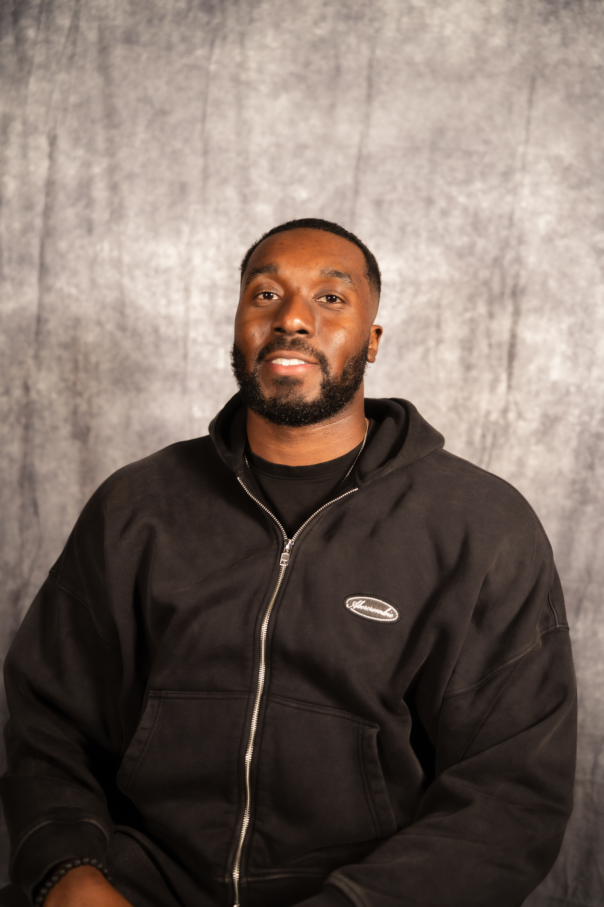

YOUR HOST
CYRUS BRYANT
Training Enablement Lead
Microsoft Dynamics 365 Business Central
[ ADD PHOTO HERE ]
IT Apprenticeship
→
IT Support roles
→
Consultancy Internship
→
Presales
Kings Rising is a tech community for men, united by a shared mission to grow personally and professionally by executing faster together.
kingsrising.co.uk
Notes:
This is your intro slide. Speak it — don't read it.
Cover three things quickly:
1. Who you are and where you work
2. How you got into tech (the non-traditional route)
3. What Kings Rising is and why you built it
Keep this to 90 seconds. The goal is to establish credibility and connection, not a full biography.
Replace the placeholder with a photo of yourself before presenting.

Slide 3
OBJECTIVES
01
Identify core tech skills for 2026
02
Recognise your transferable skills
03
Mapping tech roles to your background
04
How to manage tech skill gaps
Notes:
30 seconds max. Tell the room what they are about to get.
Each section builds on the one before it. By the end they will know what they have, where it fits, and exactly what to do next.
If one thing lands tonight, write it down before you leave.

Slide 4
YOU DON’T NEED TO HAVE EVERY SKILL ON A JOB ROLE
Notes:
End the content section with this.
The skills are already there. The work now is learning how to name them, frame them, and say them clearly.

Slide 5
WHAT IS A SKILL?
Notes:
Pause on this.
People overcomplicate it. If you could do it yesterday and you can do it again today — that is a skill. Full stop.

Slide 6
FOUNDATION
A skill is something you can do well, on purpose, more than once because you’ve learned or practiced it
Not a Qualification
A certificate proves you studied something
A skill proves you can actually do it
Built by Doing
You learn a skill by practising it, making mistakes, getting feedback and trying again. You have to try, to gain a skill.
Notes:
Keep this simple.
A skill is not something you are. It is something you can do.
Ask the room: think of something you do at work that you are good at. Could you teach someone else how to do it? If yes — that is a skill.
The three points here just clear up the common confusion. People think they don't have skills because they haven't framed what they do as skills.

Slide 7
CORE TECH SKILLS
Data Literacy
Process Thinking
01
Reading reports, spotting trends and critical thinking.
04
Understanding how something works step by step. Spotting where it breaks.
Digital Tool Fluency
Simplifying complex language
02
Learning new software fast and without panicking. The specific tool matters less than the ability to adapt.
05
Ensure ideas are easy to understand so people can take action quickly and with confidence.
AI Awareness
Problem Solving
03
Understanding how to use AI to be more productive in your role.
06
The ability to identify issues, understand their root cause and apply logical solutions to fix them effectively.
Notes:
These six skills are not specific to one role or one industry. They show up in every team, every company, at every level.
For each one, connect it back to something people in the room already do. Data literacy — has anyone read a weekly report or tracked a target? Process thinking — has anyone ever redesigned how something is done at work?
The point is recognition, not new information. They already have these. We are just naming them.

Slide 8
WHAT IS A TRANSFERABLE SKILL?
Notes:
Pause on this.
People overcomplicate it. If you could do it yesterday and you can do it again today — that is a skill. Full stop.

Slide 9
A transferable skill is acquired in one role/industry that can be used in different role/industry.
The personal qualities, behaviours, and abilities you develop over time
Notes:
Use the analogy. It lands immediately.
The skill doesn't disappear just because you changed the room you're standing in.
The last point is the one that matters for this room. Managing, communicating, organising, solving problems — none of that is industry-specific. It travels.

Slide 10
DO I HAVE TRANSFERABLE SKILLS?
Notes:
Pause on this.
People overcomplicate it. If you could do it yesterday and you can do it again today — that is a skill. Full stop.

Slide 11
1
When have I solved a problem that others were stuck on?
Problem solving
When have I explained something in a way that finally made sense to someone?
2
Communication
3
When have I had to figure something out with no instructions?
Adaptability
4
When have I spotted something that needed fixing and just fixed it?
Initiative
Notes:
Read each question slowly. Give 8 to 10 seconds between each one.
You want people to actually think about a real moment — not just nod.
After all four, ask: how many of these felt familiar? Almost every hand should go up.

Slide 12
TEACHERS & TUTORS
OFFICE ADMINS & RECEPTIONISTS
• Explaining things simply
• Turning messy processes into clean ones
• Designing how people learn
• Picking up new tools quickly
• Presenting to any audience
• Catching errors in data
• Managing difficult conversations
• Keeping the team focused
NURSES & HEALTHCARE WORKERS
POLICE & EMERGENCY SERVICES
• Staying calm in a crisis
• Staying calm when things break down
• Accurate record keeping
• Finding out why — not just what
• Following strict processes
• Spotting risks before they happen
• Putting the user's needs first
• Writing clear and precise reports
RETAIL & HOSPITALITY
LOGISTICS & DRIVERS
• Spotting where things go wrong
• Finding the most efficient way to do things
• Managing time and people under pressure
• Knowing how one delay breaks everything
• Fixing problems fast on the spot
• Noticing a small problem before it gets big
• Keeping track of what's moving
• Adapting in real time when plans change
SALES & RECRUITMENT
LAWYERS & PARALEGALS
• Asking the right questions
• Finding the hidden risk in any plan
• Persuading people to say yes
• Structuring arguments that follow clear logic
• Managing things from start to finish
• Reading large amounts of detail without missing anything
• Understanding what the market wants
• Making sure things stay fair and within the rules
Notes:
Read through each industry. Pick the two or three that feel closest to the room you are in.
For each one, point at a skill and ask: who here does this every week?
These are not soft, vague qualities. They are specific capabilities with real names. The goal is for people to leave this slide thinking: I already do three of those things and I never called them skills before.
Pause after you go through them. Ask: which one is you?

Slide 13
UNDERRATED SKILLS
SOFT SKILLS ARE HARD TO TEACH
Active Listening
Really hearing what someone is saying not just waiting for your turn to speak.
Empathy
Putting yourself in someone else’s shoes and understanding where they’re coming from.
Critical Thinking
Not just accepting what you are told. Asking why. Working out what is actually going on.
Organisation
Knowing what you need to do, keeping track of it, and actually doing it. Sounds simple. It is rarer than you think.
Notes:
The point of this slide: these skills are hard to teach in a classroom. People either have them or they are still building them.
If you came from a job that required any of these — caring for people, managing a team, handling complaints, organising events, supporting customers — you already have a head start.
Ask the room: which of these do you use every week right now?

Slide 14
SOFT SKILLS ARE RECOGNISED BEFORE AN INTERVIEW
Notes:
Pause on this.
People overcomplicate it. If you could do it yesterday and you can do it again today — that is a skill. Full stop.

Slide 15
PERSONAL INSIGHT
SUPPORT ROLE → CONSULTANCY INTERNSHIP
Problem Diagnosis
Cross-team Communication
Finding the real issue — not just the one described
Bridging technical and non-technical people constantly
Client Communication
Ownership & Accountability
Explaining technical fixes in plain language
A ticket raised is a ticket owned until resolved
Staying Calm Under Pressure
Curiosity & Self-learning
High-volume, high-stakes environment every day
Figuring out systems without a guide
Documentation & Process
Prioritisation
Writing up what was done and why, for the next person
Multiple open issues, one person, limited time
Reading the Room
Consultancy Mindset
Who is frustrated, who is lost, who just needs reassurance
Understanding what the client needs, not just what they asked for
Notes:
This is about how skills are actually built — not by reading about them, not by doing a course, but by doing the work repeatedly until it sticks.
Every skill on this slide was built the same way: show up, do the thing, make mistakes, adjust, do it again. Support is one of the best training grounds that exists because the volume of situations you face is relentless.
The key message: a consultancy internship didn't require a consulting CV. It required someone who already thought like a consultant — which is what support had been building the whole time.
Ask the room: what has your current or last job been building in you, without giving it a name?

Slide 16
PERSONAL INSIGHT
PRESALES → TRAINING ENABLEMENT LEAD
Storytelling & Communication
Objection → Confusion Handling
Explaining complex solutions to different audiences
Pushback in demos became questions in training sessions
Running Demos & Presentations
Product Depth
Live demos became structured training sessions
Already understood the system — now teaching others to use it
Simplifying Complexity
Structuring Information
Technical features turned into clear, usable workflows
Demo flow → learning journey. Same discipline.
Reading the Room
Confidence & Presence
Different personas, knowledge levels, emotional states
Leading sessions, owning the room, holding attention
Solution Mapping
Relationship Building
Presales: problems → solutions. Training: gaps → outcomes
Trust with prospects became trust with learners and clients
Notes:
This is the most personal slide in the deck. Tell it from experience.
The key message: I didn't go from presales to training because someone said I was qualified. I went because the skills were already built — through doing the job every day and through mentoring people outside of work for years before that.
Mentoring is where I practised simplifying things without the safety net of a job title. Where I had to earn trust, not be handed it. Where I learned what questions people actually ask versus what you expect them to ask.
Ask the room: is anyone here building skills in their own time — mentoring, teaching, coaching, volunteering? That counts. It all counts.

Slide 17
WHERE DO YOU WANT TO GO AND WHY?
Notes:
Pause on this.
People overcomplicate it. If you could do it yesterday and you can do it again today — that is a skill. Full stop.

Slide 18
TECH ROLES
TRANSFERABLE SKILLS FOR TOP TECH ROLES
AI / ML Engineer
🔥HIGHEST
AI Product Manager
🔥HIGHEST
Curiosity • Self-learning • Problem solving • Attention to detail
Listening • Empathy • Prioritisation • Communicating clearly
Cybersecurity Architect
🔥HIGHEST
Solutions Architect
HIGH
Process thinking • Spotting gaps • Risk awareness • Documentation
Client reading • Storytelling • Needs analysis • Presentation
Data Engineer
VERY HIGH
Data Scientist
HIGH
Organisation • Accuracy • Spotting patterns • Logical thinking
Curiosity • Asking the right questions • Reporting • Spotting trends
Cloud Architect
VERY HIGH
UX / UI Designer
HIGH
Planning • Coordination • Understanding systems • Communication
Empathy • Observation • Understanding people • Clear communication
DevOps / Platform Eng.
VERY HIGH
Technical Trainer
GROWING
Process improvement • Problem solving • Reliability • Team support
Explaining things • Patience • Simplifying complexity • Reading the room
Full-Stack Engineer
HIGH
Customer Success Manager
GROWING
Creativity • Self-learning • Breaking problems down • Persistence
Relationship building • Listening • Problem solving • Staying calm
Notes:
Point at a role. Say the name. Then read the skills underneath.
Ask the room: how many of you already do at least two of those things every week?
Every hand should go up. That is the moment.
The heat tags show demand level — HIGHEST = most hiring right now. GROWING = earlier stage but real opportunities, especially for people coming from non-tech.
The message: these roles are not out of reach. The skills that get you through the door are already in the room.

Slide 19
MANAGING SKILL GAPS
COURSES
APPRENTICESHIP
Short online courses build foundations fast. Put it into practice.
Learn on the job while earning. Apprenticeships exist at all levels including senior roles in tech.
VOLUNTEER
LEARN IN YOUR OWN TIME
Offer your time to a startup or community project. Reach out to founders or small business to see how you can help.
YouTube. Podcasts. Books. The knowledge is free. What costs is consistency.
INTERNSHIP
BUILD SOMETHING
Structured entry into an organisation. Many are paid. Most are designed for career changers too.
Build something small. Create a project. Apply it for your desired tech role.
Notes:
Coursera, LinkedIn Learning, Google Career Certificates.
This slide is permission.
Most people rule themselves out of roles before they even try because they see a skill they don't have and assume it is over.
Walk through each option. For each one, give a real example of someone who used that route — ideally from your own experience or from Kings Rising.
The apprenticeship one is personal. Use it. Talk about how you got into tech through a leaflet. That is the whole point of this slide.

Slide 20
YOU DON’T START FROM ZERO.
START WHERE YOU ARE WITH WHAT YOU'VE GOT
Notes:
End the content section with this.
The skills are already there. The work now is learning how to name them, frame them, and say them clearly.

